Slide 1
Quality Assurance of Software and Information Systems white-box Techniques

Slide 2
Black Or White
Does not address the question of whether or not the program matches the specification
Does not tell you if all of the functionality has been implemented
Does not discover missing program logic
White
Black
Impossible to write a test case for every possible set of inputs and outputs
Some of the code may not be reachable without extraordinary measures
Specifications are not always complete
Notes:
• Start with black-box test cases
(equivalence partitioning, boundary value analysis,
cause effect graphing, test derivation with formal methods, …..)
• Check white-box coverage
( statement-, branch-, condition-, ….. coverage )
• Use a coverage tool
• Design additional white-box test cases for not covered code

Slide 3
Testing Interface To An Application
Web Browser
Presentation Layer
Business Layer
DB Layer
Persistence Layer
Notes:
3

Slide 4
Structure-based or White-box Techniques
Structure-based or white-box testing is based on an identified structure of the software or the system.
Structure-based techniques serve two purposes:
test coverage measurement and structural test case design.
They are often used first to assess the amount of testing performed by tests derived from specification-based techniques, i.e. to assess coverage. They are then used to design additional tests with the aim of increasing the test coverage.

Slide 5
White testing techniques
Statement coverage
Decision coverage
Condition coverage
Path (Decision/condition) coverage

Slide 6
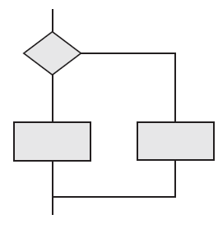
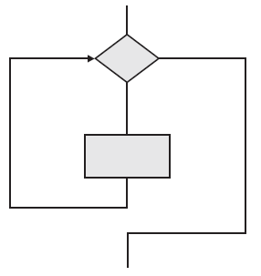
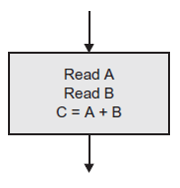
Flow Charts
Statement Decision loop

Slide 7
Example
If ((A>1) & (B=0)) then
X=X/A;
END;
If ((A==2) | (X>1)) then
X=X+1;
END;
END;
a
A > 1
AND
B = 0
c
X = X / A
b
A = 2
OR
X > 1
e
X = X + 1
d

Slide 8
1- Statement Testing
To exercise all statements at least once. What would be the values of a, B and X?
A=2 and B=0 (ace)
a
A > 1
AND
B = 0
c
X = X / A
b
A = 2
OR
X > 1
e
X = X + 1
d
Notes:
Relatively weak criterion
Weakest white-box criterion

Slide 9
Statement testing and Coverage
Statement coverage is determined by the number of executable statements covered by (designed or executed) test cases divided by the number of all executable statements in the code under test.
If we test every “executable” statement we call this full or 100 per cent statement coverage.
Weakest white-box criterion

Slide 10
2- Decision/Branch Testing
Each decision has a true and a false outcome at least once
A=2 and B=0 (ace)
A=1 and X=1 (abd)
a
A > 1
AND
B = 0
c
X = X / A
b
A = 2
OR
X > 1
e
X = X + 1
d

Slide 11
Decision Testing and Coverage
Decision coverage, related to branch testing, is the assessment of the percentage of decision outcomes (e.g., the True and False options of an IF statement) that have been exercised by a test case suite.
Decision coverage is determined by the number of all decision outcomes covered by (designed or executed) test cases divided by the number of all possible decision outcomes in the code under test.
Decision testing is a form of control flow testing as it follows a specific flow of control through the decision points.
Decision coverage is stronger than statement coverage; 100% decision coverage guarantees 100% statement coverage, but not vice versa.

Slide 12
Other Structure-based Techniques
There are stronger levels of structural coverage beyond decision coverage, for example, condition coverage and multiple condition coverage.
The concept of coverage can also be applied at other test levels For example, at the integration level the percentage of modules, components or classes that have been exercised by a test case suite could be expressed as module, component or class coverage.
Tool support is useful for the structural testing of code.

Slide 13
3- Condition Coverage
Each condition in a decision takes on all possible outcomes at least once
Conditions: A>1, B=0, A=2, X>1
A=2, B=0, and X=1 (ace)
A=1, B=1, and X=4 (abe)
a
A > 1
AND
B = 0
c
X = X / A
b
A = 2
OR
X > 1
e
X = X + 1
d

Slide 14
4- Path Coverage
Every unique path through the program is executed at least once
How many test cases?
A=2, B=0, X=4 (ace)
A=2, B=1, X=1 (abe)
A=3, B=0, X=1 (acd)
A=1, B=1, X=1 (abd)
a
A > 1
AND
B = 0
c
X = X / A
b
A = 2
OR
X > 1
e
X = X + 1
d
Notes:
Strongest white-box criterion
Usually impossible: infinitely many paths ( in case of loops )
So: not a realistic option
But note : enormous reduction w.r.t. all possible test cases ( each sequence of statements executed for only one value )

Slide 15
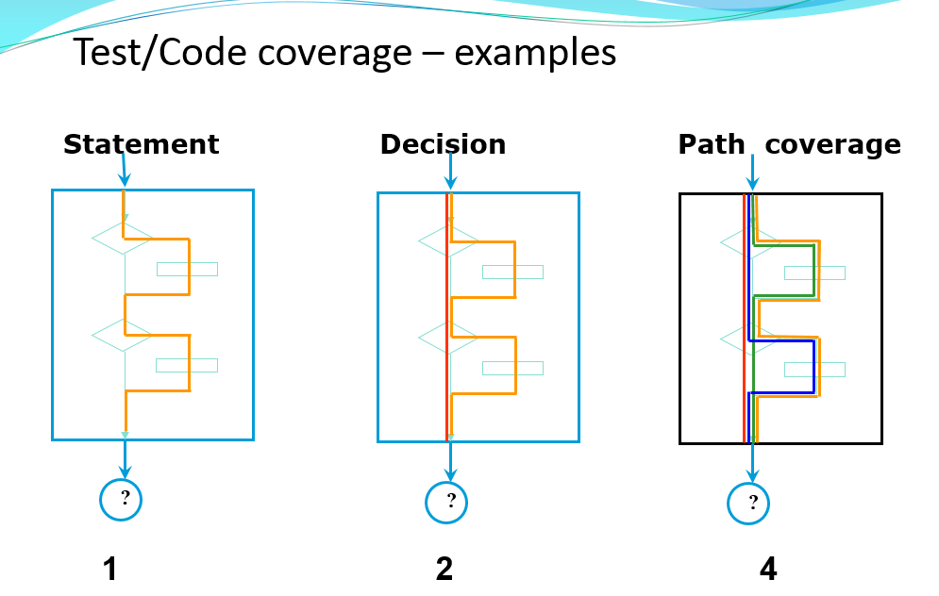
Test/Code coverage – Examples

Slide 16
THANK YOU

